Slide 1
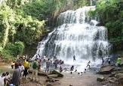
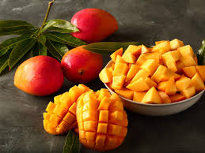
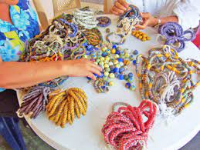
YILO KROBO MUNICIPAL ASSEMBLY
LOCAL ECONOMIC DEVELOPMENT

Slide 2
What is Local Economic Development (LED)?
LED is defined as “the process by which local governments, local businesses and other actors join forces and resources to enter into new partnership agreements with each other or other stakeholders to create new jobs and stimulate economic activity in municipalities, towns and villages''(Ghana's National Decentralization Policy, 2010).
LED is a process. This process provides the opportunity for the citizenry to participate in the local development process

Slide 3
Brief Description of The Municipality
Main Characteristics
Land size | 514.7 km sq
Population. | 122,705
Growth Rate(2021 PHC) | 3.2% Annually(2021PHC)
Sex Ratio | 93 males to 100 females
Dominant Ethnic Group | Krobos,Ewes,Ga-Adangbe
Economy | Industry(25%),Service(15%),Agriculture(60%)
Tourism. | Kloyosikplemi festival,krobo mt,Boti fall,Nsutapong water-fall fall,Alokwem water-fall,umbrella-rock,3-headed palm tree,snake-like palm tree

Slide 4
Focus of The TOMACABE PROGRAMME
Our focus revolves around adding values to local resources that are available, accessible in the municipality and has a comparative advantage, to create job avenues for the growth of the municipality.

Slide 5
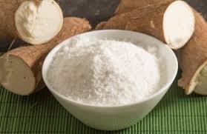
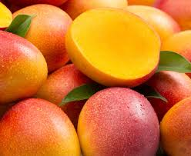
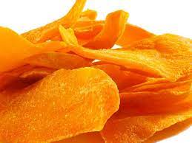
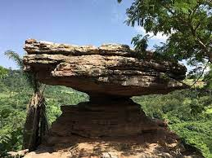
LED PRODUCTS
PRODUCT A
PRODUCT B
PRODUCT C

Slide 6
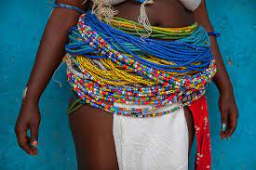
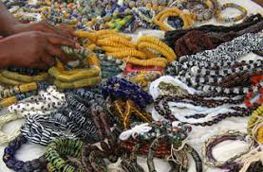
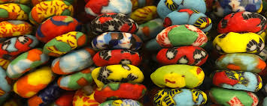
Product d

Slide 7
SELECTED TOMACA PRODUCTS
Processed cassava into fortified gari
Processed mango into juice & chips
Tourism(entertainment, events etc
Municipal economy

Slide 8
To create jobs, increase incomes and ultimately reduce poverty and improve the quality of life for the people of Yilo Krobo Municipal Assembly

Slide 9
Description of TOMACABE Programme
Product B (Developed Krobo mountain into tourist site) | Product B (Processed mango) | Product C (Processed cassava)
Develop the Krobo mountain into one of the first class eco-tourism park in the country In 2020 the travel & tourism sector in Ghana contributed nearly USD 1.9 billion to the country’s GDP. PPP Act,2020 Act 1039 Abundance of undeveloped tourist attraction sites within the municipality Job creation. Improved IGF | Processing of mango into juice and chips and improvement of quality of mango fruits to meet the international markets The hub of mango production in the country where about 13 exotic mango varieties can cultivated The Municipality falls within the international zone where mango fruits & harvested twice in a year In 2020 the yield was 15 mt per hectare & area cultivated was 3,325 hectares(production was 49,875 mt) In 2020post-harvest loss was estimated to be about 40% due to Bacteria Blight Spot(BBS) | Processing of cassava into other fortified gari. Over 60% of the entire population of the municipality are farmers. 55% of these farmers cultivate cassava. As at 2020 cassava yield stands at 29.8 mt per hectare and land cultivated was 8,012.4 hectares(production was 238,769.5 mt). Two existing small scale processing facilities. In 2020 post-harvest loss was estimated to be about 20% Improved IGF

Slide 10
Product D (Beads)
Producing beads for domestic and international markets Leading producer of beads in the country Improve sanitation by 30% through recycling Increase export Improved IGF

Slide 11
Krobo Mountains | Mango Processing into mango Juice & Chips | Cassava processing into fortified Gari | Beads
To develop the Krobo mountain into one of the first-class eco-tourism parks in Ghana. To Improve IGF by 70% by the end of 2027 To Reduce unemployment by 40% by the end of 2027. | Reduce post-harvest loss by 30% by the end of 2027. Build capacity of 60% of mango farmers in order to improve quality by the end of 2027 Improve income of farmers. Link over 50% processors to bigger markets by the end of 2027. | Reduce post-harvest loss by 15% by the end of 2027. Improve income of farmers Reduce unemployment by 40% by the end of 2027. Link over 50% processors to bigger markets To build the capacity of 200 women who are into cassava farming, processing and marketing by the of 2027 To Improve IGF by 70% by the end of 2027 | To Improve IGF by 70% by the end of 2027 To Reduce unemployment by 40% by the end of 2027 To improve the income of bead producers and designers

Slide 12
Output Indicators
Developed Krobo Mountain into tourist attraction | Processed mango into juice & chips | Processed cassava into fortified Gari | Beads
Developed tourist facility at Krobo Mountain. Increased number of tourists in the Municipality | Increased in mango production for domestic and international market Increased processing of mango Reduction in post harvest losses Improved farming technologies of farmers Increased market for mango | Increase production of Cassava by 50% Reduction in post harvest losses Number of women whose capacities have been built Increased in market linkages Increased adoption of new technologies | Increase production and marketing of beads 50% Improvement of sanitation Number of women whose capacities have been built Increased in market linkages

Slide 13
Strategies.
Krobo mountain | Processed Mango | Processed Cassava | Beads production
Public-Private Partnership | Ensure sustainable supply of raw material(mango) Existence of registered mango seedling producers FBOs(2,000,000/annum) About 4No.sister districts also produce mango Most farmers are GLOBAL GAP certified. Ghana Enterprise Agency Public-Private Partnership 1D1F Programme Introduce product both local & international market and online marketing platforms. Business regulatory requirement and business formalization Facilitating licensing regimes for investors | Ensure sustainable supply of raw materials(cassava) Formalise existing cassava growers association. Creation of out-grower scheme Introduction of improved varieties. Training of farmers on GAP in cassava production. Public-Private Partnership Business support services through Ghana Enterprise Agency 1D1F Introduce product both local & international market and online marketing platforms. Business regulatory requirement and business formalization Securing access to micro-credit Encouraging youth into cassava farming Mechanizing the production of cassava Facilitating licensing regimes for investors | Ghana Enterprise Agency Public-Private Partnership Introduce product both local & international market and online marketing platforms. Business regulatory requirement and business formalization Facilitating licensing regimes for investors

Slide 14
Activities.
Developed Krobo mountains into Tourist Site | Processed Mango(mango juice & mango chips) | Processed Cassava(Fortified gari) | Beads
Develop a winning concept note Pre-feasibility studies Consultative engagement with key stakeholders | Signing of MoU with out-growers & other famer groups Signing of MoU with private investor(s) Organise training programmes for farmers on improved and efficient production Liaise with Stakeholders on strategies aimed at improving marketing of products | Signing of MoU with out-growers & other famer groups Signing of MoU with private investor(s) Organise training programmes for farmers on improved and efficient production Liaise with Stakeholders on strategies aimed at improving marketing of products Facilitate and support the formation of (10) women groups Offer technical and technological support | Organise training programmes for beads producers on improved and efficient production Liaise with Stakeholders on strategies aimed at improving marketing of products Facilitate and support the formation of cooperative societies Offer technical and technological support Organize client exhibition shows

Slide 15
stakeholders
Private sector
Regulatory bodies (Standard authorities, Register general, Regulatory bodies etc)
Farmer-Based Organizations
Chiefs/Traditional Authorities/Family land Leaseholds
Agric Dept/ Ghana Enterprises Agency
Krobodan
Micro Finance Institutions

Slide 16
LEGISLATION,POLICY & PROGRAMME IN SUPPORT OF TOMACABE PROGRAMME
Tourism | Mango | Cassava. | Beads
Tourism Act, 2011 Act 817 Local governance Act, 2019 Act 936 Local Economic Development Policy(2020) and Action Plan The Coordinated Programme of Economic and Social Development Policies. | National Micro, Small and Medium Enterprise(MSME) Policy (2019). PFJ,1D1F,PERD and Micro, Small and Medium Enterprise Fund. The Coordinated Programme of Economic and Social Development Policies. Rural Development Policy(2018). | National Micro, Small and Medium Enterprise(MSME) Policy (2019). PFJ,1D1F,PERD and Micro, Small and Medium Enterprise Fund. The Coordinated Programme of Economic and Social Development Policies. Rural Development Policy(2018). | Local governance Act, 2019 Act 936 Local Economic Development Policy(2020) and Action Plan The Coordinated Programme of Economic and Social Development Policies.

Slide 17
FINANCIAL INDICATIVE BUDGET
Developed Krobo Mountains into Tourist Site |  | Processed Mango into juice and Chips |  | Processed Cassava into fortified Gari
Budget. | Funding Source | Budget line | Funding Source | Budget. | Funding Source
GHC5,000,000.00 | PPP EXIM Bank IGF DACF | GHC 70,000.00 | PPP EXIM Bank IGF | GHC 50,000.00 | EXIM Bank GEA(IFAD,AFDB PPP IGF
Beads
Budget. | Funding Source
GHC 100,000.00 | EXIM Bank GEA(IFAD,AFDB PPP IGF

Slide 18
Impact Indicators
Sustainable Jobs and wealth creation Alternative livelihood Poverty reduction Enhanced foreign exchanged | Sustainable Jobs and Wealth created Alternative livelihood Poverty reduction Reduced post-harvest loss Enhanced foreign exchanged | Women empowerment Sustainable Jobs and Wealth created Alternative livelihood Poverty reduction Reduce post-harvest losses Enhanced foreign exchange | Sustainable Jobs and Wealth created Alternative livelihood Poverty reduction Improved sanitation

Slide 19
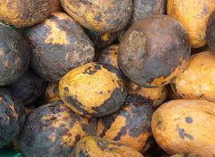
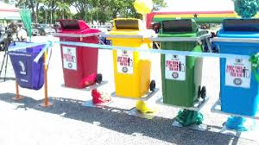
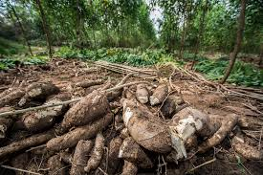

Slide 20
Tourism Value Chain Analysis
Advertising tourist on products, contract
Transport to destination.
Provide accommodation, food etc
Organise experiences, eventsexp
Transport from sites
Travel Agents
Air, Rail, Bus company
Hotel
Site operator, cultural group
Bus company
Coordinated services
Tour operator
Local tourism board

Slide 21
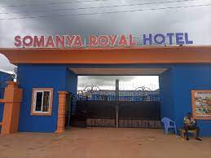
Tourism

Slide 22
Processed mango into juice & chips value chain
Inputs
Production
Parking & cold storage
Processing
Distribution
Marketing & Sales
Fresh mango
Processing companies
Seedlings
Importers(wholesale/dedicated suppliers)
Supermarkets
Fertilizers
Dried: chips
Food services
Agrochemicals etc
Puree: juice
Small farms
Medium & large farme
Exporter companies
Small scale retailers
Farm equipment
Parking plants
Internet
Irrigation equipment
Cool storage unit
Large producer-exporter Co.
Farms
Parking plant
Cool storage unit

Slide 23
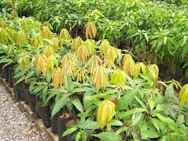
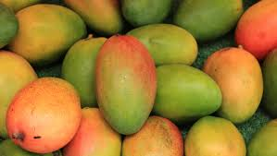
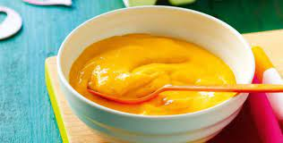
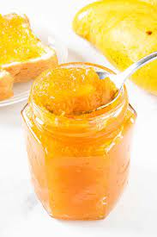
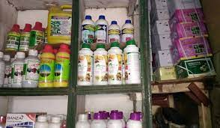
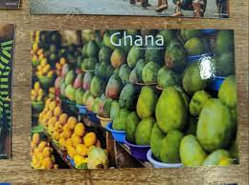
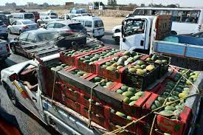
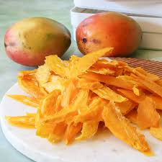
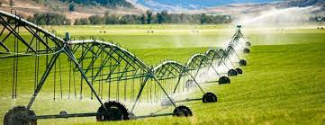
inputs
Production
Processing
Haulage
Products
Mango puree, jam, chips, juice

Slide 24
Cassava value chain
Consumers
Regional exporters
Urban consumers
Rural consumers
Urban consumers
Rural consumers
Retailing
Cross border
Urban market
Local mkt
Rod side mkt
Retail shops
Local market
Processing
Small-scale farm processors
Small-scale processors, co-operative processors
Large scale collectors
Large scale middlemen
Large scale middlemen
Production.
Small holder cassava farms.
Enabling environment
Ecological
Social
Economic
Political

Slide 25
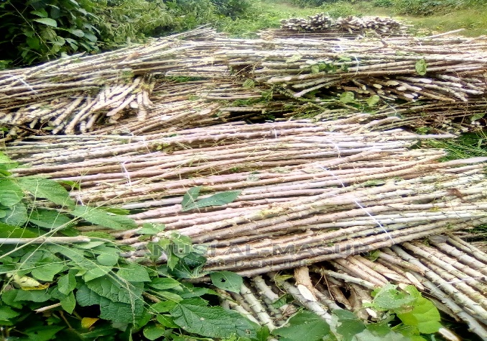
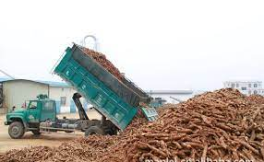
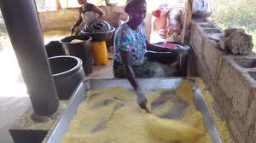
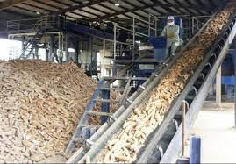
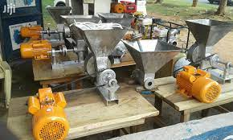
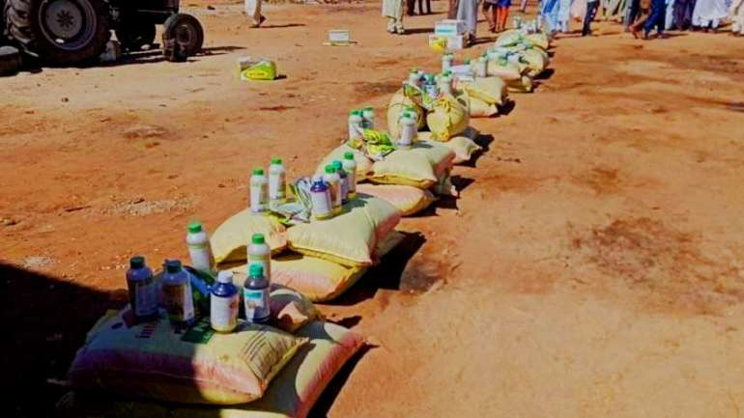
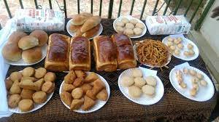
Cassava

Slide 26
Value chain analysis on beads
Input supply
Production
Designing
Wholesalers/Retailers
usage

Slide 27
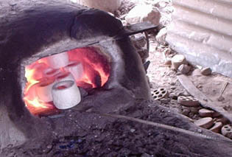
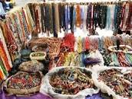
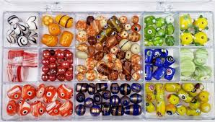
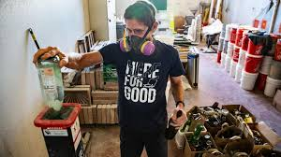
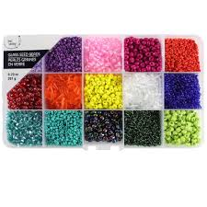
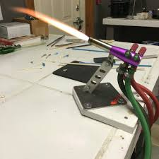
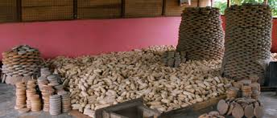
inputs
Production
Marketing

Slide 28
TOMACABE GALlARY – krobo mountains

Slide 30
Krobo mountains

Slide 31
Krobo mountains

Slide 32
Fortified gari

Slide 33
Cassava processing factory

Slide 34
Mango processing factory

Slide 35
FUNCTIONS OF ECONOMIC DEVELOPMENT COMMITTEE
Coordinate the implementation of identified tasks by responsible department and or agencies
Ensure capacity development of all stakeholders
mobilize resources to support LED; Develop and implement appropriate communication strategy
collate documentation on LED work Facilitate national
regional and district work including LED platforms,
develop framework and make recommendations to the Advisory Council Undertake joint monitoring and evaluation activities

