Slide 1
TOURISM POTENTIALS OF
YILO

Slide 2
CONTENT
PERSONAL INTRODUCTION
WHAT IS TOURISM
TOURISM POTENTIAL IN YILO
ADVANTAGES / BENEFITS IN TOURISM
TOURISM PRODUCT DEVELOPMENT
TOURISM SITES AND DESTINATIONS IN
PICTURES
GOVERNMENT SUPPORT
IMPROVEMENT SO FAR
FINANCIAL ANALYSIS / REVENUE
MODERN TOURISM MODEL
(CONTENPORARY STRATEGIES)
CHALLENGIES FACING YILO TOURISM
MARKET
WAY FORWARD / SUGGESTIONS
CONCLUSIONS

Slide 3
WHAT IS TOURISM
Tourism is about the movement of people from one place to the other in search of leisure, pleasure, and rejuvenation for a short period of time.
Tourism can also be defined as, the study into cultural norms, values, folklore, forts, castles, life style, food, Rhythms, dance forms, marriages, history, heritage, natural environment, flora and fauna, mountains, valleys, water falls, cricks, lakes, ponds, rivers, caves, birds and wildlife

Slide 4
TOURISM POTENTIALS IN YILO
Tourism in Yilo cannot be over emphasized because of the diverse tangible and intangible tourism potentials which will give way to a lot of development like;
A better community for residents
Lots of jobs
More creative entrepreneurs skills
Opportunity for all
More peaceful and tolerant
environment
Solidarity and cohesion.

Slide 5
TOURISM POTENTIALS IN YILO
Boti Falls
The Boti waterfall, located in a Forest Reserve at Boti near Huhunya, is a very important national tourist attraction site. Both nationals and foreigners visit the fall. Facilities at the Fall have been improved extensively. The guest house, summer huts and caretaker’s residence have been renovated and pavement constructed right from the entrance to the guest house. Drains have also been constructed at the shoulders of the pavement to carry storm water and to check erosion. The execution of these works together with the institution of effective operation and management has given Boti Falls a facelift and boosted patronage.

Slide 6
TOURISM POTENTIALS IN YILO
The River Ponpon, which supplies water to the Fall, dries up at certain times of the year, especially between December and April due to problems with the maintenance of the Reserve protecting the river. Efforts are being made by the Municipal Assembly and the Municipal offices of the Ministry of Food and Agriculture and Forestry Services Division to curb bad farming practices and illegal felling of trees for fuel wood and charcoal in the Reserve and along the river upstream.

Slide 7
TOURISM POTENTIALS IN YILO
The “Umbrella Rock
Adjacent to the Boti Falls is the “umbrella rock” and nearby is a unique palm tree with three heads (branches). Another unique feature is the coiled palm tree located at Yiwase, which is not far from the Boti waterfalls. Krobo Mountains
Another potential is the Krobo Mountains located at the intersection of Accra – Akosombo and Somanya – Akuse roads. This Mountain was the original home of the Krobo people. Some traditional structures still exist and some cultural activities are carried out there.
Access roads to the Krobo Mountains, the Unique Palm Trees and the Umbrella Rock have been improved and are motorable throughout the year.

Slide 8
TOURISM POTENTIALS IN YILO
The people of Yilo Krobo in November each year celebrate Kloyosikplemi festival. This festival attracts a lot of people into the municipality during the period.
However, some of these tourism potentials are yet to be developed to a standard that would attract and keep visitors.
The Municipal Assembly is resolutely determined and it is in the process of developing the tourism potentials to make them an effective instrument for job creation and diversification of the municipality’s revenue base.

Slide 9
TOURISM POTENTIALS IN YILO
Krobo Beads
Three Headed Palm Tree
Snake-Like Palm Tree
Akaa Falls
Ahabaso Ancient Caves

Slide 10
TOURISM POTENTIALS IN YILO
The table below shows the list of the tourist sites and their respective locations.
list of underdeveloped tourist sites
ZONAL COUNCIL | FEATURE | LOCATION
Oterkpolu | Tobacco beach(beach) | Oterkpolu.
Obawale | Waterfall. | Obawale-Ogome
 | Cave. | Ahabeso-Yilo
 | Stream With yellowish colour | Patso-tsebi

Slide 11
ADVANTAGES / BENEFITS
ADVANTAGES:
Preserving heritage, wildlife folklore, way of life, reduction of poverty, preservation, housing and overall being
BENEFITS:
Improve of local infrastructure,
Branding of country and Yilo,
Foreign exchange,
Change of attitude and behavior,
Revitalization of Yilo city and more.

Slide 12
TOURISM PRODUCT DEVELOPMENT
Tourism product is a service packaged for people of all kinds to purchase while visiting a new destination.
These will help visitors to explore the destinations they are visiting by offering them the chance to view and experience attraction.
Eg. Mounting Biking Tours for active cyclists, Hiking, Theme park development, Golfing etc.

Slide 13
PICTURES

Slide 14
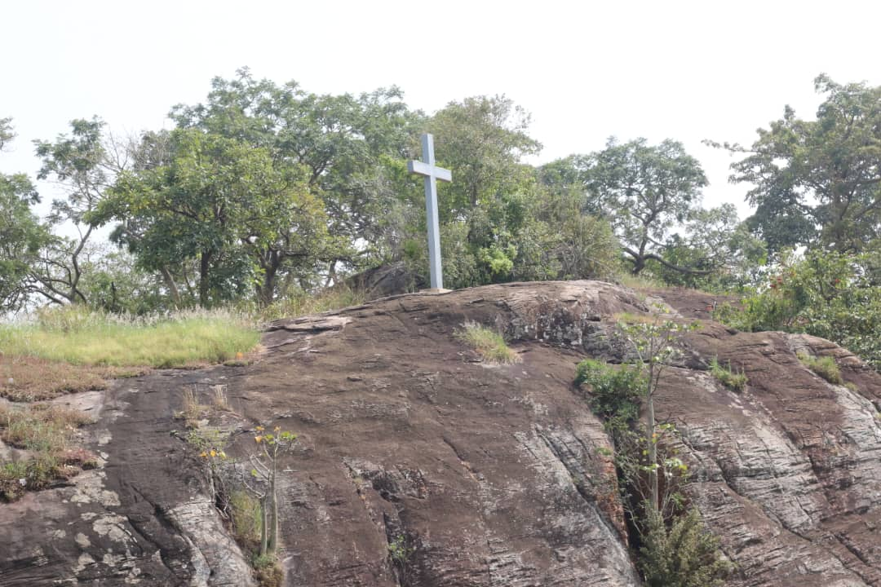
PICTURES

Slide 15
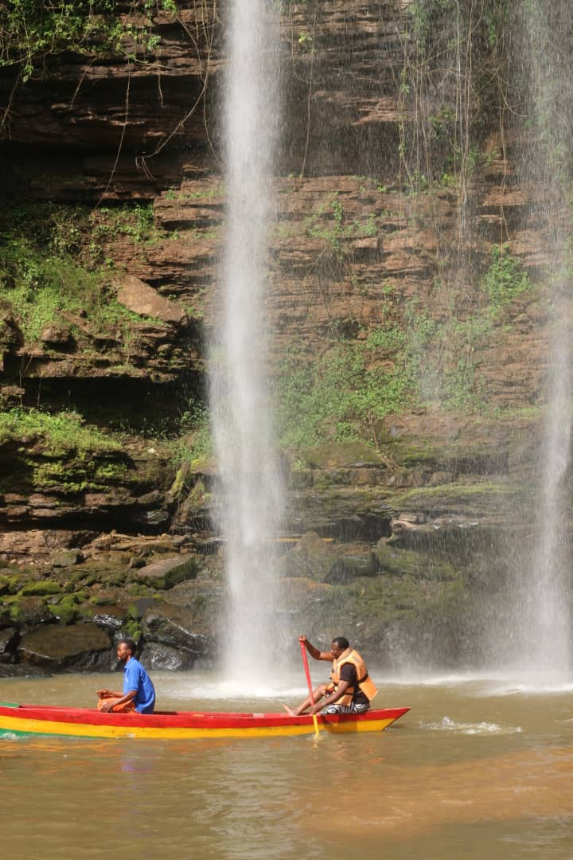
PICTURES

Slide 16
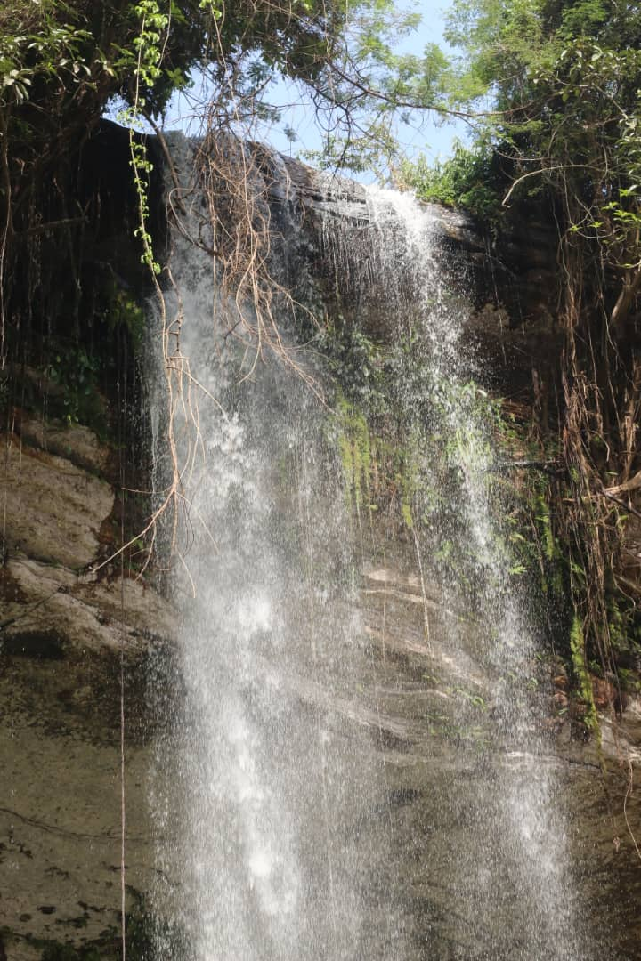
PICTURES

Slide 17
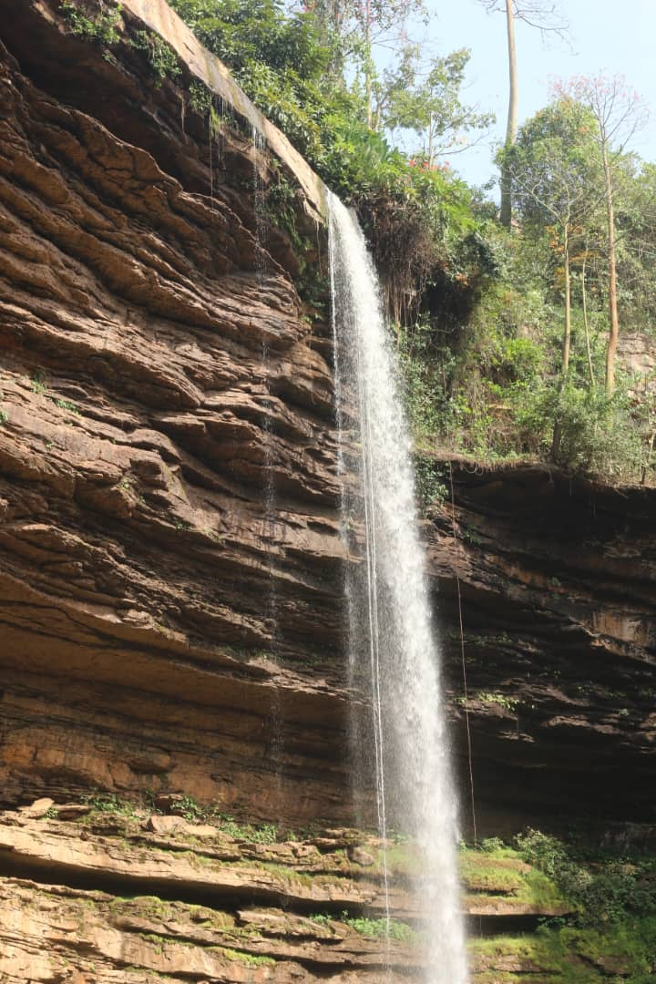
PICTURES

Slide 18
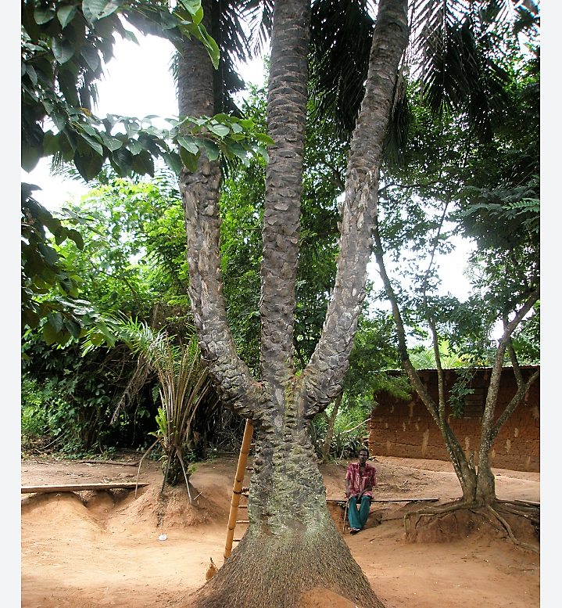
PICTURES

Slide 19
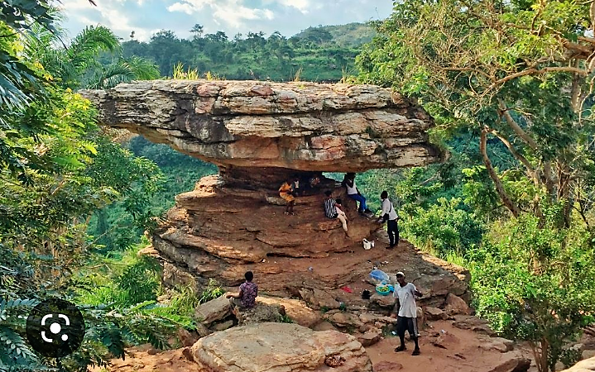
PICTURES

Slide 20
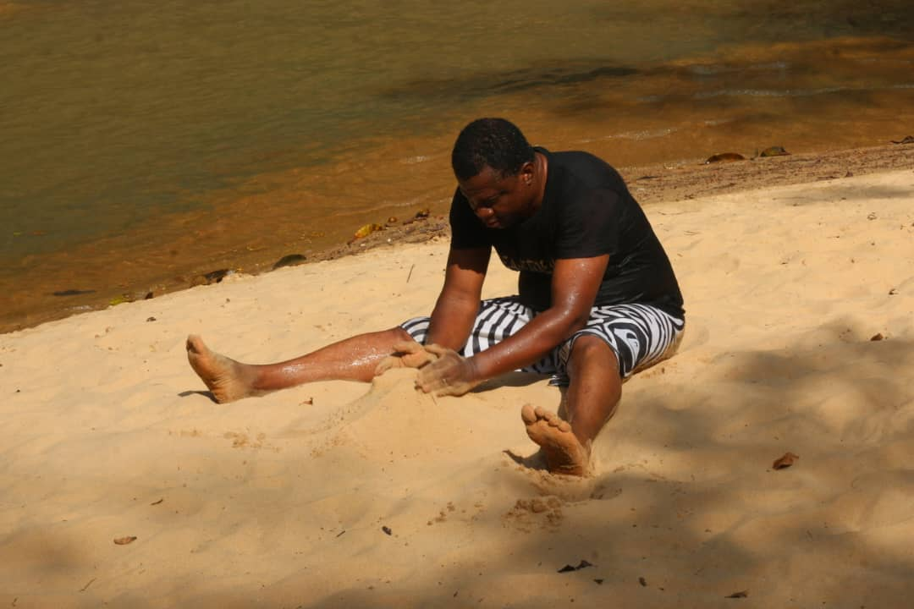
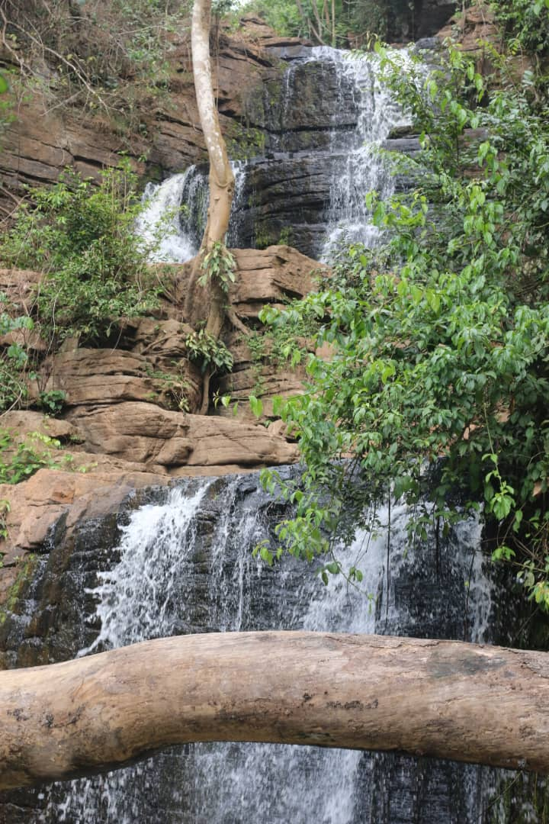
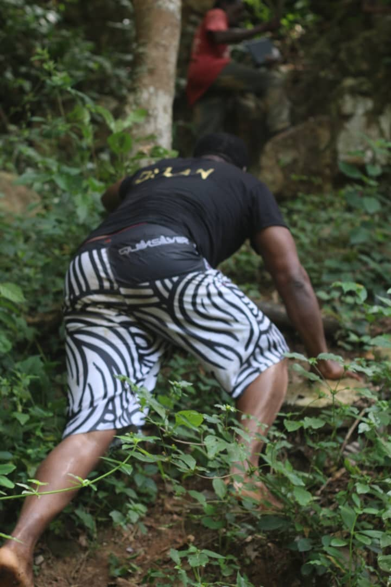
PICTURES

Slide 21
GOVERNMENT SUPPORT
Collaboration with Government, the mother ministry and agencies for the necessary promotional tools, Highlight main attractions, Identify your targets and visitors,
Focus on rebranding, Seeking partnerships, Serious marketing focus, Ensure pleasant entry and exit of tourists, Highlight the story of the area.
Trade show and Giving our website global touch.

Slide 22
SOME IMPROVEMENTs SO FAR
Research into Yilo tourism
Potential
Documentary on Yilo Tourism
Hospitality
Training of site guides

Slide 23
FINANCIAL ANALYSIS / REVENUE
tourist visit in a month
AT Boti falls
Rate | Frequency | Percentage
Once | 182 | 70%
Twice | 36 | 14%
Thrice | 26 | 10%
Four above | 16 | 16%
Total | 260 | 100%

Slide 24
FINANCIAL ANALYSIS / REVENUE
VISITS BY LEVEL OF EDUCATION
LEVEL OF EDUCATION | FREQUENCY | PERCENTAGE
None | 31 | 12%
JHS | 63 | 24%
SHS | 109 | 42%
TERTIALLY | 57 | 22%
TOTAL | 260 | 100%

Slide 25
FINANCIAL ANALYSIS / REVENUE
1. Travel cost
2. Social economic characteristics
3. Total tour spots at Boti fall area
4. Quality of the falls

Slide 26
MODERN TOURISM MODEL (CONTERPOLARY STRACTERGY)
Modern tourism theme park with
Equipment
Redesign beautiful tourism
Architectural buildings
Tourism equipments for leisure and pleasure for
Children
Adult
Literates
Tourists
Security agencies
Government officials

Slide 27
MODERN TOURISM MODEL (CONTERPOLARY STRACTERGY)
Proper marketing strategy
Stake holders involvement
Government support / policy
Golf course / Mini sport complex
Athletics complex

Slide 28
CHALLENGIES FACING YILO TOURISM MARKET
Litigation over the facilities
Improper accounting system
Bad road network
Lack of electricity to the facilities
Lack of good stair cases and rails to the facility
Improper marketing policy (promotion)
Unqualified tour guides and site guides
Ownership and maintenance culture
Cost of fares at various sites
No sign post for directions to most sites

Slide 29
WAY FORWARD / SUGGESTIONS
Stake holder involvement
Capital injection into the sector
Seek foreign tourism investment
Tourism documentary on Yilo
Create tourism and heritage desk
More research into tourism in Yilo

Slide 30
CONCLUSIONS
If tourism can bring about development such as, infrastructure development, peace and solidarity, maintenance of our cultural heritage, and add to the gross domestic product of our country then, let us think tourism, let us create tourism for leisure, pleasure, rejuvenation and the social economic development of all.

Slide 31
Thank you

